Slide 1
i C u - Automated Proctoring System
Allen Y (TVE19CS011)
Elsa Maria Joseph (TVE19CS030)
Divina Josy (TVE19CS028)
Guided by,
Prof. Lubi E

Slide 2
Introduction
With the growing popularity of online education, it has become necessary to ensure the authenticity and credibility of student assessments.
Online class proctoring systems have emerged as a reliable solution to address this need
An online class proctoring system is a software tool that monitors students during their online classes, exams and assessments, ensuring that they abide by the rules and guidelines set forth by the instructor.
Online class proctoring systems offer a variety of benefits to instructors and students alike.

Slide 3
Literature Review

Slide 4
[1] “Smart Class Room Monitoring System”,
Priya B., Radhamani V, Santhana Prasanth P, Suchitra S, Suganthi S, International Journal of Engineering and Advanced Technology (IJEAT)
ISSN: 2249-8958 (Online), Volume-9 Issue-2, December, 2019
Brings forth a Monitoring system for smart (traditional) classrooms using Arduino with sound sensors and IR sensors
IR sensors are used for the purpose of attendance as well as to measure student density
Sound sensors are used to observe whether students are maintaining silence in class

Slide 5
[2] Telal Mirghani Hassan Khalid, "Classroom Management in Virtual Learning: A Perceptions Study with School Teachers in Qatar," World Journal of English Language, Sciedu Press, vol. 12(2), pages 1-93, December 2022.
Aim of this study is to analyze the issues of virtual classroom management throughout the COVID-19 pandemic from the teacher's perspective
The main points of analysis were teachers’ challenges, beliefs and attitudes
Reached conclusion that teachers find it difficult to manage virtual learning platforms
Puts forth recommendations for teachers to improve on their skills

Slide 6
[3] “Students live behaviour monitoring in online class using artificial intelligence”,Dr. M. Neelakantappa,G. Apoorva,D. Santosh Kumar, A. Akshatha, K. Sai Manoj
Aims to create a system that automatically supports teachers in monitoring student behavior.
Helps in understanding students interest for respective class.
Student characteristics are captured throughout framework and data is analysed.
Face Detection, Shape predictor model, Modules-Client, Server, Face processing modules were used
Notes:
work related to eye movements, oral movements, head movements and analysis are
performed in the case of a student working in that class.

Slide 7
[4] Fakhar, S.; Baber, J.; Bazai, S.U.; Marjan, S.; Jasinski, M.; Jasinska, E.; Chaudhry, M.U.; Leonowicz, Z.; Hussain, S. “Smart Classroom Monitoring Using Novel Real-Time Facial Expression Recognition System”. Appl. Sci. 2022, 12, 12134. https://doi.org/10.3390/app122312134
Proposed method of recognizing emotions of students from their facial expressions.
Effects of facial expressions on classroom learning were analysed
Facial expressions of happy, sad, satisfied, concentration, dissatisfied and fear were selected.
Facial features for each emotion are initially detected using HOG for face recognition, and automatic emotion recognition is then performed by training CNN.

Slide 8
Gaps identified
Majority of the proposed methods are applied to real-time classrooms and could translate better in a virtual setting
Some of the methods are very general monitoring methods and do not focus on individual student mannerisms
In [2], teachers are given suggestions for improvement while not acknowledging added difficulties of virtual classroom environments as compared to traditional one
Each methods addresses only one aspect of proctoring

Slide 9
Problem Statement
To create an online class monitoring AI system that can help teachers identify disengaged or struggling students, and detect potential cheating or misconduct in real-time, improving the overall quality and effectiveness of online education

Slide 10
Objectives
Track eyeballs and report if candidate is looking left, right or up.
Find if the candidate opens his mouth by recording the distance between lips at starting.
Instance segmentation to count number of people and report if no one or more than one person detected.
Find and report any instances of mobile phones.
Head pose estimation to find where the person is looking.

Slide 11
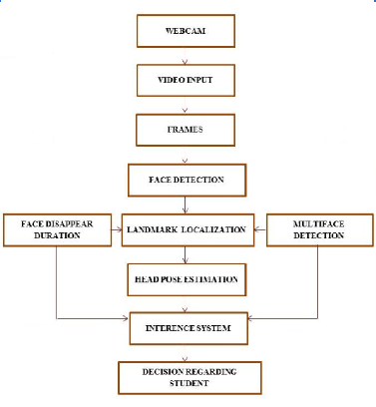
Design Diagram

Slide 12
Proposed Solution Methodology

Slide 13
Gaze Tracking
Real-time eye tracking using OpenCV and Dlib
Facial keypoints detector that can detect eyes in real-time needed
Dlib library is selected because it can give predictions in real-time
The facial keypoint detector takes a dlib rectangular object as input, which represents the face's coordinates.

Slide 14
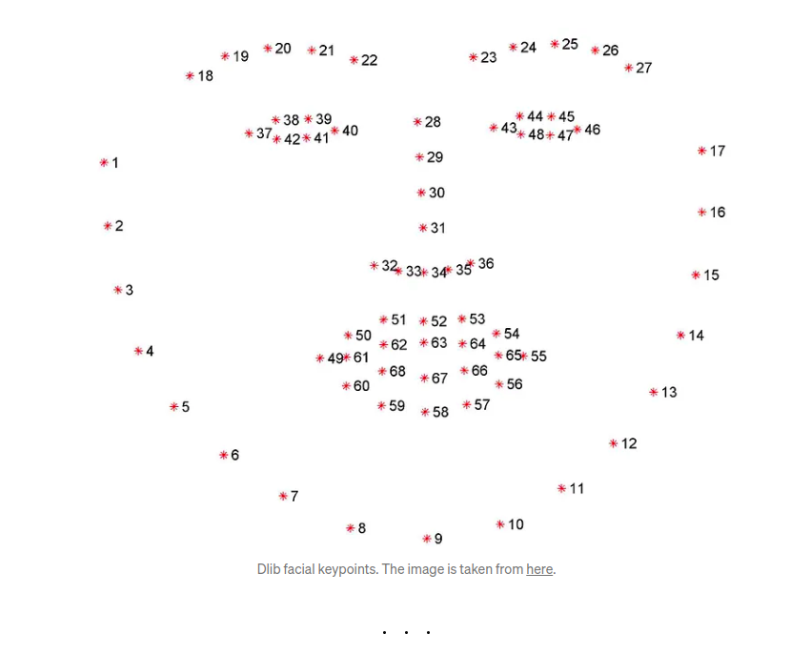
Work with the live feed obtained through webcam
Center of eyeballs is found using OpenCV

Slide 15
Mouth Detection
Similar to eye detection
Dlib’s facial keypoints are again used for this task
Distance between the lips keypoints is noted for 100 frames and averaged.
Infringement is reported if the distance between at least three outer pairs and two inner pairs increases beyond a certain value when the user opens their mouth.

Slide 16
Person Counting and Mobile Phone Detection
Pre-trained weights of YOLOv3 trained on the COCO dataset to detect people and mobile phones in the webcam feed.
If the count is not equal to 1, an alarm can be raised (Person Counting)
Check if any class index in the COCO dataset is 67, which corresponds to mobile phones, in order to report a mobile phone.

Slide 17
Head Pose Estimation
Uses OpenCV and Tensorflow
Caffe model of OpenCV’s DNN module to detect face
Uses a CNN model from trained specifically for facial landmark detection.
An annotation box if created around the box
Angles of head tilt are obtained with the help of this annotation box
If angle is <=48 or >=-48 along either axes, anomaly is reported.

Slide 18
Implementation Results

Slide 19
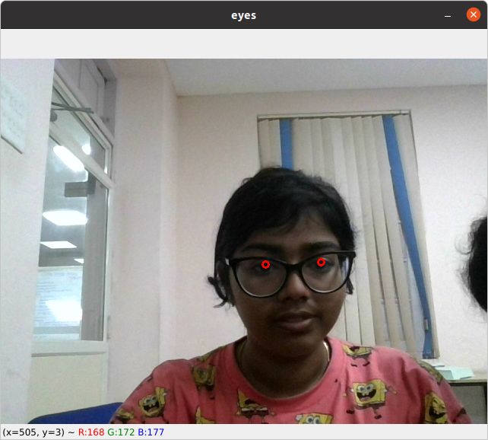
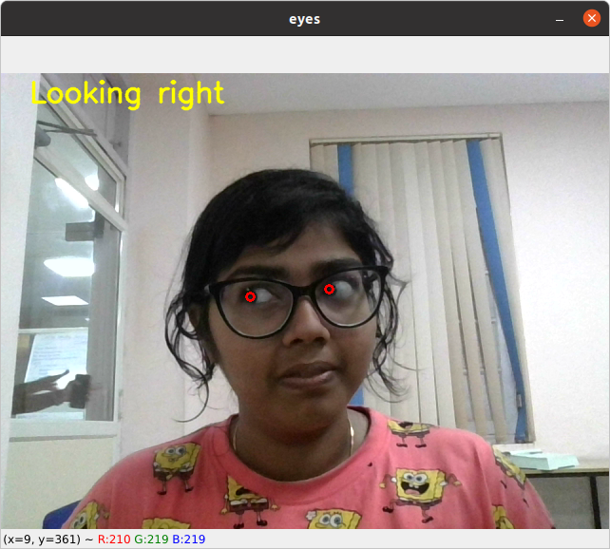
Gaze Tracking

Slide 20
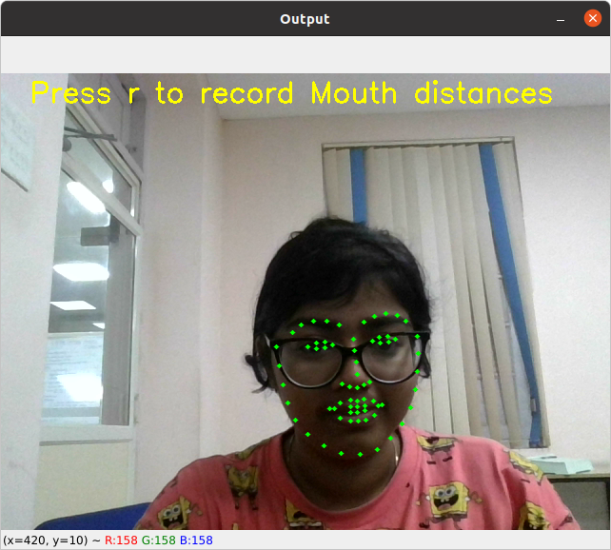
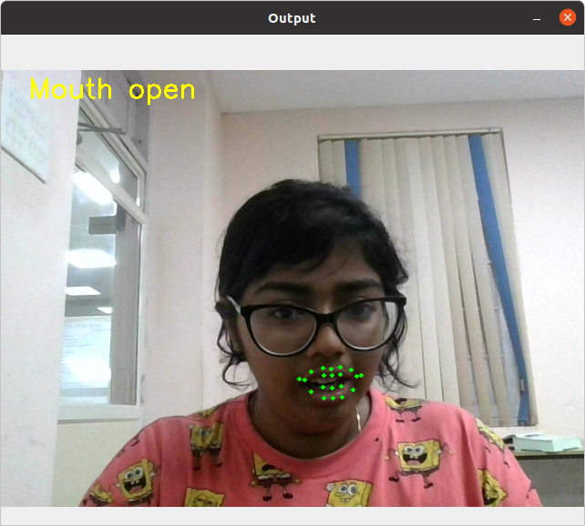
Mouth Detection

Slide 21
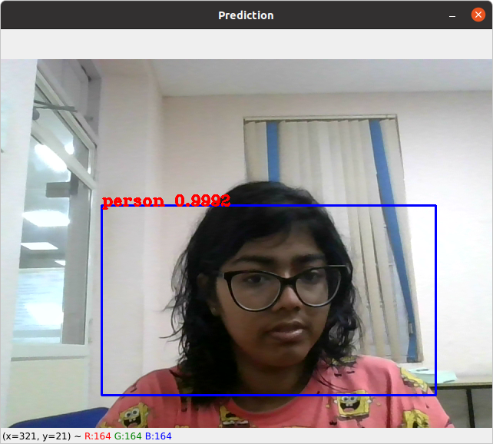
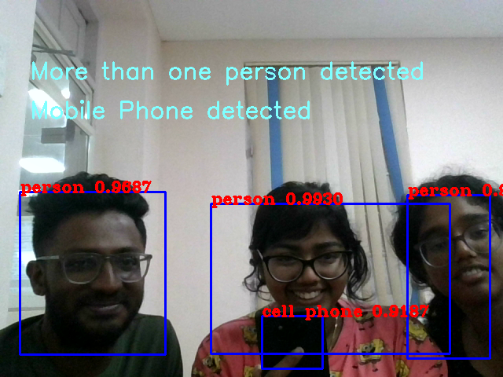
Person Counting and Mobile Phone Detection

Slide 22
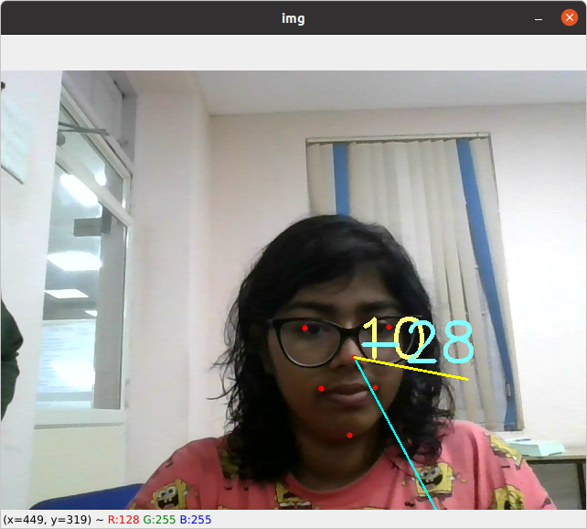
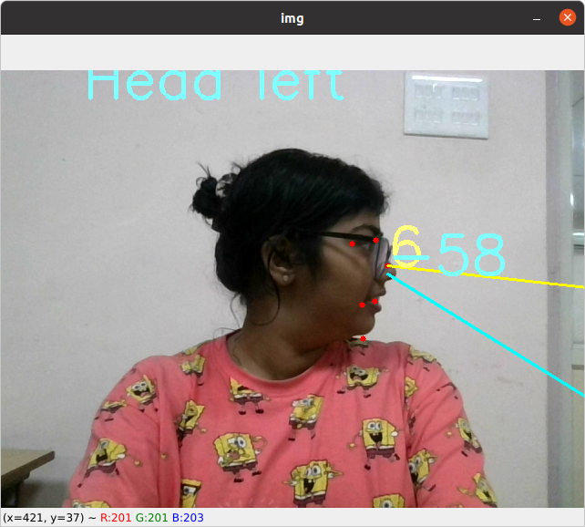
Head Pose Estimation

Slide 23
Conclusion

Slide 24
Conclusion
Implement a strategy to carry out proctoring for classes in online settings:
Eye tracking to track distracted students
Mouth detection to check for talkative students
Head pose detection to check if student is moving around too much
Person counting and mobile phone detection to ensure student itself is attending class without being distracted by phone.

Slide 25
Future Scope
Possible works in this field that can be explored in the future include:
Check for multiple tabs open in browser during class/exam
Face recognition to identify the student attending class
Student attendance management system
True face detection
Audio monitoring features

Slide 26
References
[1] “Smart Class Room Monitoring System”,Priya B., Radhamani V, Santhana Prasanth P, Suchitra S, Suganthi S, International Journal of Engineering and Advanced Technology (IJEAT) ISSN: 2249-8958 (Online), Volume-9 Issue-2, December, 2019
[2] Telal Mirghani Hassan Khalid, "Classroom Management in Virtual Learning: A Perceptions Study with School Teachers in Qatar," World Journal of English Language, Sciedu Press, vol. 12(2), pages 1-93, December 2022.
[3]“Students live behaviour monitoring in online class using artificial intelligence”,Dr. M. Neelakantappa,G. Apoorva,D. Santosh Kumar, A. Akshatha, K. Sai Manoj
[4] Fakhar, S.; Baber, J.; Bazai, S.U.; Marjan, S.; Jasinski, M.; Jasinska, E.; Chaudhry, M.U.; Leonowicz, Z.; Hussain, S. “Smart Classroom Monitoring Using Novel Real-Time Facial Expression Recognition System”. Appl. Sci. 2022, 12, 12134. https://doi.org/10.3390/app122312134

Slide 27
Thank you

